Slide 1
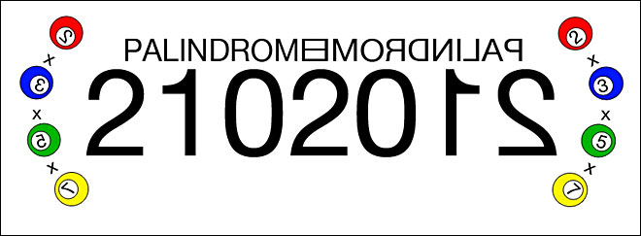
Palindrome Number

Slide 2
Concept of Palindrome number
A palindrome number is a number whose digits, with decimal representation are the same when read from backwards.
For example:
12321
12344321
4567887654
When we reverse all digits, the number before and after reversing have to be the same.

Slide 3
Algorithm/Pseudo code
start
declare parameters num, digit, reverse as integer;
read num;
copy num into n; //because num will be used in computation, we save n for later.
initialise reverse = 0; //any int using for calculation must be initialise
while (n is not zero) // we use ‘while’ loop because we don’t exactly know the iteration
dig = num % 10; //extract the last digit to a single number
rev = rev * 10 + dig; //reverse the last digit of num to the first digit of reverse
num = num / 10; //delete 0 from the last digit of num
if num == reverse then the number is palindrome.
stop

Slide 4
Flowchart
START
cin >> num
n = num
n == rev
while(num>0)
num is NOT a palindrome
num is a palindrome
dig = num % 10;
rev = rev * 10 + dig;
num = num / 10;
END

Slide 5
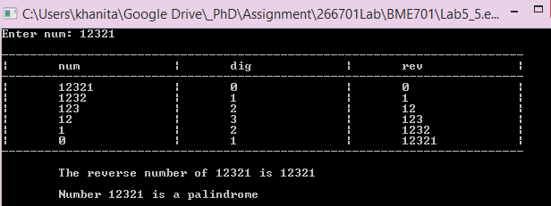
Output

